Slide 1
Arthology
دراسات عليا دكتوراة
د. علاء حسين سعدون

Slide 2
Arthrology (Syndesmyology)
An articulation or joint is formed by the union of two or more bones or cartilages by other tissue. Bone is the fundamental part of most joints; in some cases a bone and a cartilage, or two cartilages, form a joint. The uniting medium is chiefly fibrous tissue or cartilage, or a mixture of these. Union of parts of the skeleton by muscles (Synsarcosis), as in the attachment of the thoracic limb in the horse .
The articulations may be immovable, slightly movable and freely movable.
Three chief subdivisions of joints are usually recognized: synarthroses, diarthroses, and amphiarthrosis or cartilaginous joints .

Slide 3
SYNARTHROSES
In this group the segments are united by fibrous tissue or cartilage, or a mixture of the two in such a manner as practically to preclude movement. The chief class in this joint
Suture : This joint is seen in the skull bones that are united by fibrous tissue in early life but get ossified with maturity. Sutures play an important role in the young animal, allowing for the growth of the skull through the extension of individual bones at their margins while proliferation of the membrane continues.
Syndesmoses : In these, facing areas of two bones are joined by connective tissue ligaments. that more appreciable movement is possible; an example is the joint between the shafts of the radius and ulna in the forearm of the dog.

Slide 4
Gomphosis.—This term is applied to the implantation of the teeth in the alveoli.

Slide 5
2-Cartilaginous Joints
Most cartilaginous joints are known as synchondroses. These include the joints between the epiphyses and diaphyses of juvenile long bones and the corresponding joints of the base of the skull. Most are temporary and disappear after growth has ceased, when the cartilage is replaced by bone. The few permanent synchondroses include the joint between the skull and hyoid apparatus , which allows appreciable movement in some species.

Slide 6
symphysis the articulating bones are divided by a succession of tissues; usually cartilage covers the bones with fibrocartilage or fibrous tissue in the middle. The category includes the joints between the symmetrical halves of the mandible and of the pelvic girdle and the joints between the bodies of successive vertebrae .

Slide 7
Intervertebral disk (arrow) joining bodies of
adjacent vertebrae.

Slide 8
DIARTHROSES or synovial joints
These joints are characterized by the presence of a joint cavity and by their mobility. They are often called movable or true joints. This joint can be further subdivided into various types based on the number of bones making up the joint and based on the shape and degree of movement permitted at the joint.
1. Based on number of bones involved.
a. Simple joint – joint formed by articulation between two bones, e .g. shoulder joint ( scpula and humerous ) .
b. Compound joint - joint formed by articulation between more than two bones e.g. carpal joint, elbow joint ( Humerous , radious and ulna ) .

Slide 9
2. Based on the shape and degree of movement
a. Hinge joint – this joint permit movement only in one direction. E.g. elbow joint flexion and extension are possible.
b. Ball and socket or spheroidal joint joint – this joint permit twisting movement such as in rotation, circumduction, adduction, abduction. Spherical shaped of one bone fits into the cup shaped cavity of another bone making this movement possible. The hip joint is the best example; the human shoulder joint also conforms closely to the pattern, but the shoulder of domestic species largely restricts its movement to flexion and extension.

Slide 10
c. Pivot joint – joint comprises a peg fitted within a ring.in which rotary movement occur around one axis e.g. atlanto-axial joint between atlas and axis.
D - The condylar joint is formed by two knuckle-shaped condyles that engage with corresponding concave surfaces. The two complexes may be close together, as in the femorotibial joint, or widely separate and provided with independent joint capsules, as are the twin articulations of the mandible.
d. Plane joint – allows only slight gliding movement between relatively flat apposed surfaces. e.g. carpal joint, vertebral articular processes.

Slide 11
F - The ellipsoidal joint presents an ovoid convex surface that fits into a corresponding concavity. Movements are principally in two planes at right angles to each other (flexion–extension; adduction– abduction), but a small amount of rotation may be possible. The radiocarpal joint of the dog is of this variety .
E - The saddle joint (articulatio sellaris; combines two surfaces, each maximally convex in one direction and maximally concave in a second direction at right angles to the first. These are also biaxial joints, allowing flexion–extension and adduction–abduction but with a certain amount of rotation permitted or imposed by the geometry of the surfaces. An example is the distal interphalangeal joint of the dog.

Slide 12
Synovial joint structure
General structures present in most synovial joint are:
A - The joint surface , which are usually more or less expanded. They are in most cases smooth, and vary much in form. They are formed of specially dense bone, which differs histologically from ordinary compact substance.
B - Articular cartilage – that cover the opposing surfaces of bones , usually hyaline in type and differ in thickness in different joint .
C - Synovial membrane – lines the joint cavity that separate bones, it also secrets synovial fluid into the joint cavity.
D - Fibrous layer – located external to synovial membrane, joins bones, selectively thicken to form ligament (joint capsule = synovial membrane + fibrous layer).
E - Ligaments.—These are strong bands or membranes, usually composed of white fibrous tissue, which bind the bones together. They are pliable but practically inelastic.

Slide 13
Additional structures seen in some synovial joint are:
a. Meniscus – fibrocartilage in the synovial cavity interposed between bones e.g. in stifle joint
b. Internal ligament – ligament within the joint cavity connecting two bones and are surrounded by synovial membrane.
c- Fat pad – seen between synovial membrane and fibrous layer that produce folds which may protrude into joint cavity as villi.

Slide 15
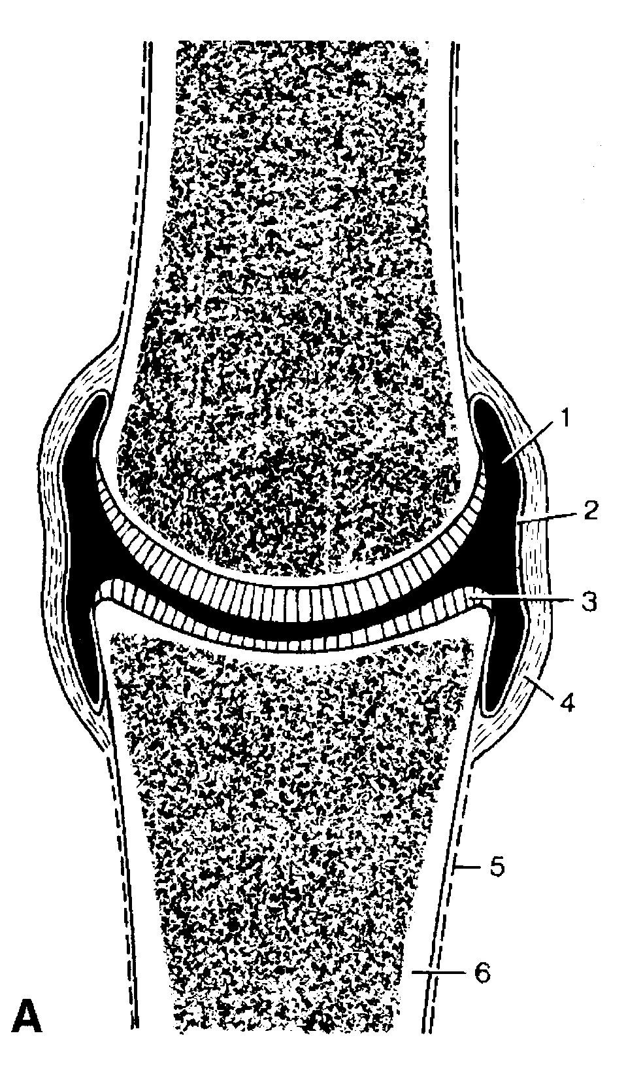
1, Joint cavity; 2, synovial membrane; 3, articular cartilage; 4, fibrous layer of joint capsule; 5, periosteum; 6, compact bone.

Slide 16
Movements
The movements of a joint are determined chiefly by the form and extent of the joint surfaces and the arrangement of the ligaments. They are usually classified as follows:
Gliding.—This refers to the sliding of one practically plane surface on another, as in the joints between the articular processes of the cervical vertebrae .
Angular Movements : In these cases there is movement around one or more axes. Motion which diminishes the angle included by the segments forming the joint is termed flexion, while that which tends to bring the segments into line with each other is called extension.

Slide 17
1
2,
3,
4
5,
Flexion, extension, and overextension illustrated by the distal part of the horse’s forelimb. 1, Flexed carpal joint; 2, extended carpal joint; 3, flexed fetlock joint;
4, extended fetlock joint; 5, overextended fetlock joint.

Slide 18
Circumduction.—This designates movements in which the distal part of the limb describes a circle or a segment of one.
Rotation: This term is reserved to indicate rotation of one segment around the longitudinal axis of the other segment forming the joint. It is seen typically in the atlanto-axial joint.
Adduction and abduction designate respectively movement of a limb toward and away from the median plane, or of a digit toward and away from the axis of the limb.

Slide 19
4
2
1
5
3
Limb movements illustrated by the femurs of
the dog, cranial view. 1, Adduction; 2, abduction; 3, circumduction;
4, inward rotation; 5, outward rotation

Slide 20
Joints of axial skeleton
1. Skull – suture joints between bones of skull
2 - Temporomandibular Joint
The TMJ is a synovial articulation between the obliquely oriented condylar process of the mandible and the mandibular fossa of the squamous temporal bone . The joint has a fibrocartilaginous disc . The articular disc divides the joint cavity into dorsal and ventral compartments.

Slide 22
2- Atlantooccipital Joint
The AO is a synovial joint between the cranial articular foveae of the atlas (C1 vertebra) and the occipital condyles on the skull.
3 - The mandibular symphysis is a fibrous joint between the rostral ends of the contralateral mandibles . In cattle, this joint ossifies later in life and is much weaker than that of the horse.

Slide 23
Vertebral Joints
For most vertebral articulations caudal to the axis (C2), there are two types of joints: (i) fibrocartilaginous joint between two successive vertebral bodies, and (ii) plane (flat) synovial joint between cranial and caudal articular processes of two successive vertebrae.
An intervertebral disc bridges the gaps between vertebral bodies. The intervertebral disc is composed of two parts: an outer annulus (or anulus) fibrosus and a central nucleus pulpous.

Slide 24
Joints of the Proximal Forelimb
Shoulder joint (aka glenohumeral joint, scapulo-humeral joint): the humeral head articulates with the glenoid cavity of the scapula. The tendon of the infraspinatus m. acts as a lateral collateral ligament with assistance from the supraspinatus m. The tendon of the subscapularis m. acts as a medial collateral ligament. The shoulder joint has no other collateral ligaments.

Slide 25
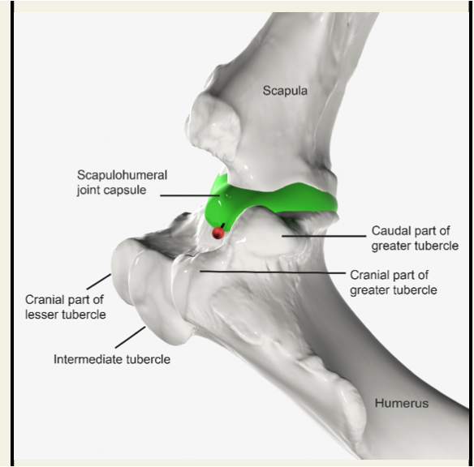

Slide 26
Elbow joint (aka cubital joint): the joint is formed by the distal end of the humerus (trochlea and capitulum) articulating with the proximal head of the radius and the trochlear notch of the ulna. The elbow joint has medial and lateral collateral ligaments.

Slide 27
The carpal joints are named, from proximal to distal:
  Antebrachiocarpal (aka radiocarpal)
  Middle carpal (aka intercarpal)
  Carpometacarpal: this joint has little to no motion.

Slide 28
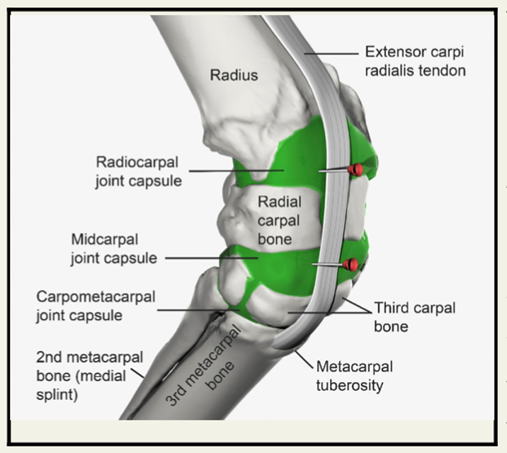
A single fibrous capsule encloses 3 synovial compartments. The synovial joint capsules are: radiocarpal (antebrachiocarpal), middle (mid)carpal, and carpometacarpal. on the dorsal surface of the carpus, the broad tendon of insertion of the extensor carpi radialis muscle and the metacarpal tuberosity serve as landmarks for injection of the joint compartments of the carpus.

Slide 30
Digital Joints
The digital joints include duplicate metacarpophalangeal (MCPfetlock), proximal interphalangeal (PIPpastern), and distal interphalangeal (DIPcoffin) joints . Each of these joints is stabilized by medial and lateral collateral ligaments. The metacarpophalangeal joints for digits III and IV communicate with each other but the rest of the interphalangeal joints remain as separate joint capsules. An interdigital fat pad is present between the medial and lateral digits . The interdigital fat pad can become infected in conditions involving the interdigital space such as foot rot or interdigital hyperplasia.

Slide 32
Joints of Hind limbs
The hip joint is a spheroidal joint formed between the lunate surface of the acetabulum and the head of the femur. The acetabular surface is enlarged by an articular labrum continuous with the transverse acetabular ligament that bridges the notch interrupting the medial wall of the socket. The walls of the articular cavity are completed by a synovial membrane supported externally by a fibrous covering. Although the fibrous capsule is not uniformly strong, there are no thickenings so definite that they need be recognized as specific ligaments.

Slide 33
However, the head of the femur is joined to the depth of the acetabulum by the intracapsular ligament of the femoral head, which is covered by a reflection of the synovial membrane. In some species this ligament is known to convey blood vessels, but the importance of these to the nutrition of the head remains uncertain. In the horse a second (accessory) ligament inserts on the non articular area of the head .
Although a spheroidal joint, the hip does not enjoy the full range of movement expected of this class of joint. In the large animals movement is largely restricted to flexion and extension; the capacity for rotation, abduction, and, especially, adduction is limited. In conformity with the dominance of sagittal movement, the articular area tends to extend onto the neck in ruminants .

Slide 34
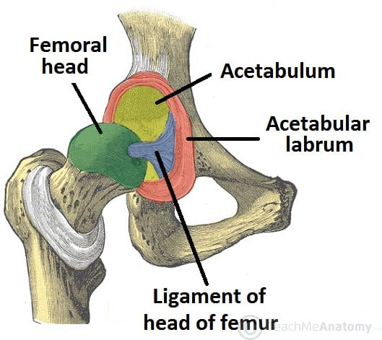

Slide 35
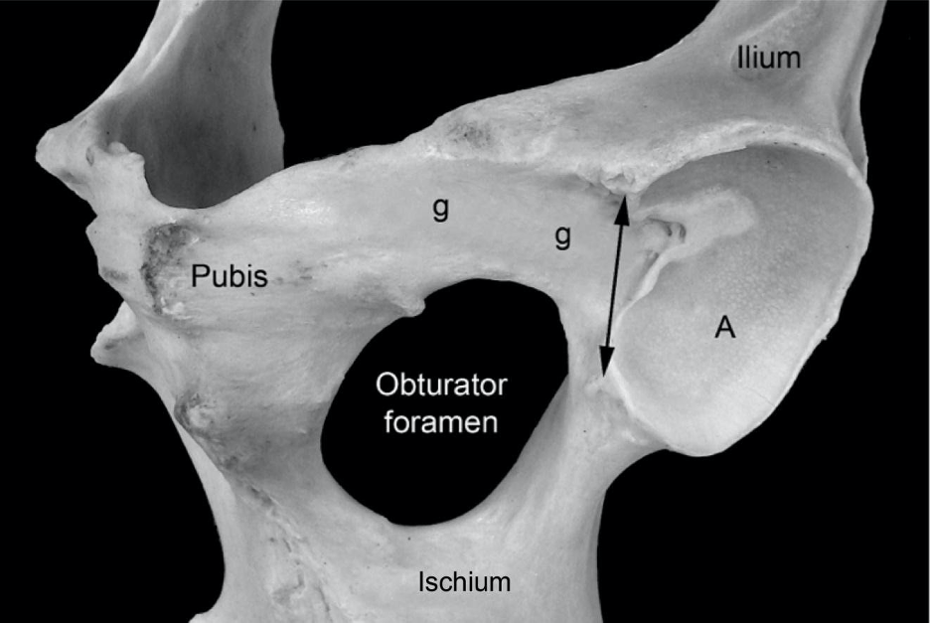
Equine left acetabulum, ventral lateral view. A, Articular surface of the acetabulum; g, shallow groove for the accessory ligament of the femoral head; double headed arrow, acetabular notch and the location of the transverse acetabular ligament.

Slide 36
The stifle joint , corresponding to the human knee, comprises femorotibial, femoropatellar, and proximal tibiofibular joints; in the dog it also includes the joints between the femur and paired sesamoids in the origins of the gastrocnemius and that between the tibia and the sesamoid in the popliteus tendon. In the dog, all these articulations share a common synovial cavity; in the large species the femoropatellar and the medial and lateral femorotibial compartments have more restricted communication with each other.

Slide 37
The joint is stabilized by paired collateral ligaments which act to prevent abduction/adduction at the joint, as well as paired cruciate ligaments . The caudal (medial) cruciate ligament runs at right angles to the cranial one and attaches far back on the tibia near the popliteal notch. The femoropatellar joint is formed between the femoral trochlea and the patella and is extended by its parapatellar cartilages, of which the medial one is especially well developed in the large animals.

Slide 38
meniscofemoral ligament.
popliteus tendon;
Medial femorpatellar ligament
caudal cruciate ligament;
lateral femoropatellar ligament;

Slide 39
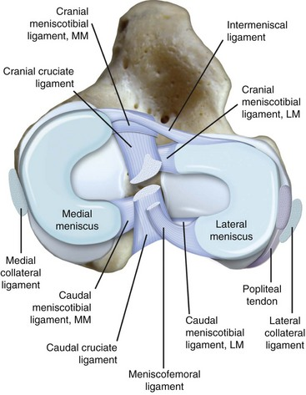

Slide 40
Hock (or Tarsus) Joint
The hock joint is a complex joint formed by four articulations. From proximal to distal, they are the tibiotarsal (or tarsocrural), proximal intertarsal, distal intertarsal, and tarsometatarsal joints. Review the bones that make up each joint. Know that the tarsocrural joint communicates with the proximal intertarsal joint. Likewise, the distal intertarsal joint communicates with the tarsometatarsal joint. The digital joints are similar to the digital joints of the forelimb.

Slide 41
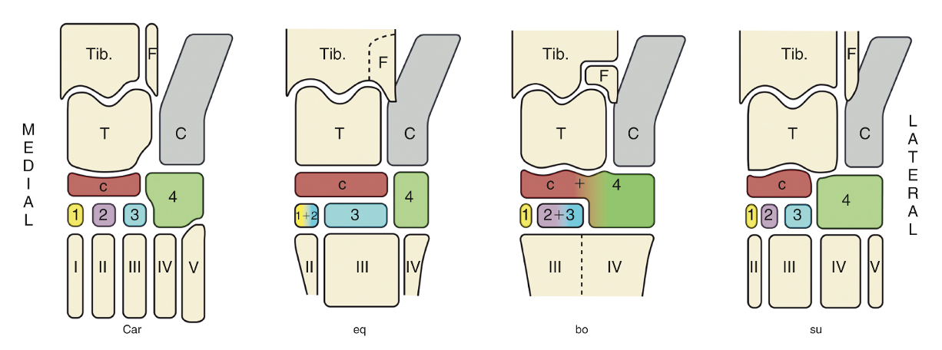
The bones of the tarsal skeleton in the carnivores (Car), horse (eq), cattle (bo), and pig (su) schematic. Roman numerals identify the metatarsal bones, arabic numerals the distal tarsal bones. C, calcaneus; c, central tarsal bone; F, fibula; T, talus; Tib., tibia. (TVA)

Slide 42
